Slide 1
Boosting Algorithms for Regression
AdaBoost, XGBoost, and LightGBM with Scikit-learn

Slide 2
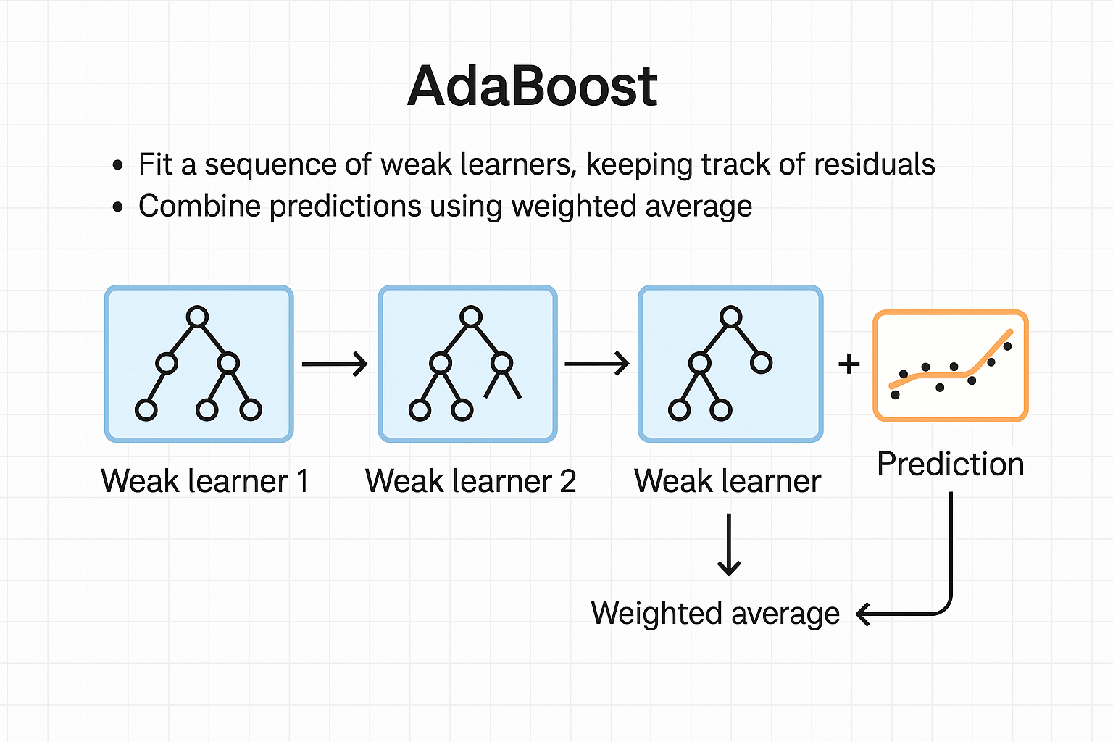
AdaBoost Regressor
Method: AdaBoost (Adaptive Boosting) combines multiple weak learners (typically decision trees) in sequence. Each model is trained to correct the errors made by the previous model. Weights are adjusted to focus more on difficult samples.
Scikit-learn Usage:
from sklearn.ensemble import AdaBoostRegressor
model = AdaBoostRegressor(n_estimators=100, learning_rate=0.1)
model.fit(X_train, y_train)
predictions = model.predict(X_test)

Slide 3
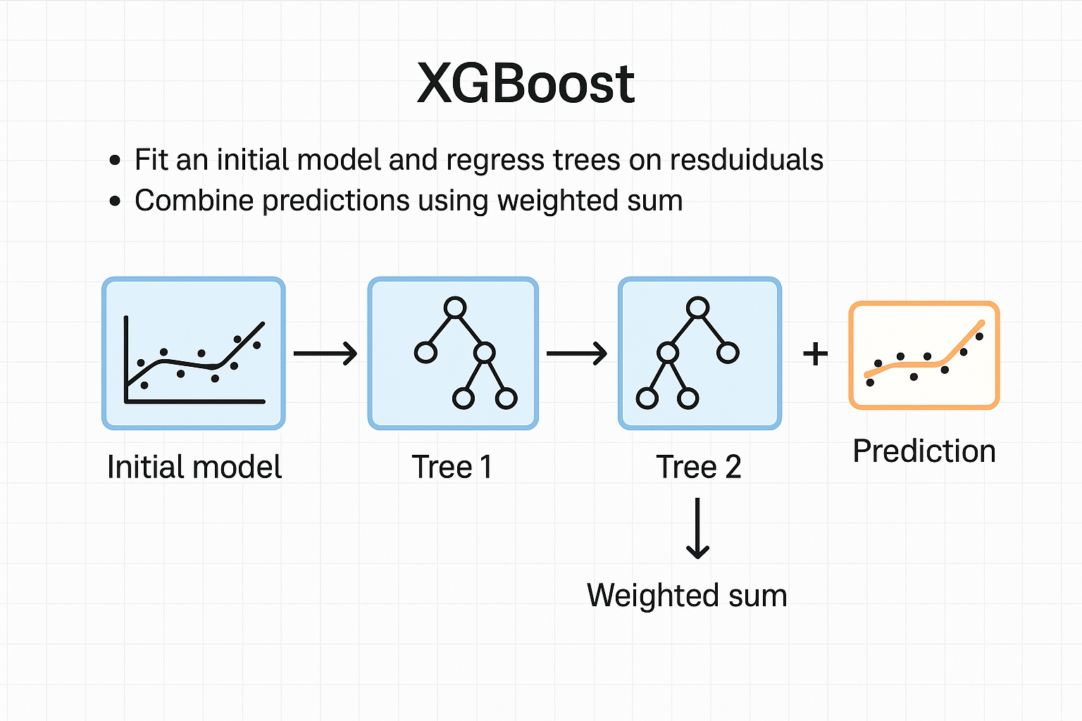
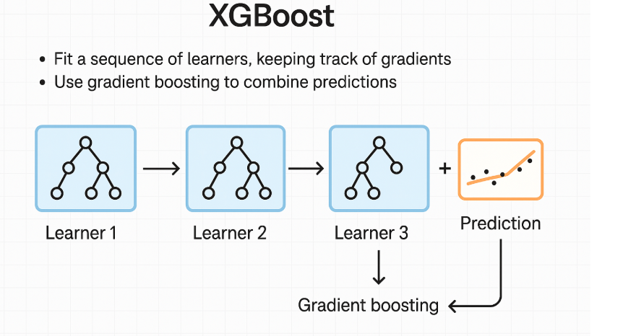
XGBoost Regressor
Method: XGBoost (Extreme Gradient Boosting) improves over AdaBoost by using gradient descent to minimize a loss function. It includes regularization to reduce overfitting, and performs parallel tree boosting for efficiency.
Scikit-learn Usage:
from xgboost import XGBRegressor
model = XGBRegressor(n_estimators=100, learning_rate=0.1)
model.fit(X_train, y_train)
predictions = model.predict(X_test)

Slide 4
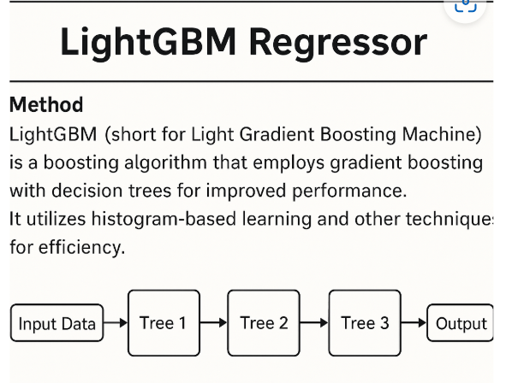
LightGBM Regressor
Method: LightGBM (Light Gradient Boosting Machine) grows trees leaf-wise rather than level-wise, resulting in faster training and better accuracy. It is optimized for performance on large datasets.
Scikit-learn Usage:
from lightgbm import LGBMRegressor
model = LGBMRegressor(n_estimators=100, learning_rate=0.1)
model.fit(X_train, y_train)
predictions = model.predict(X_test)

